Slide 1
Overview of Process Monitoring
Edward Wang, Ph.D.

Slide 2
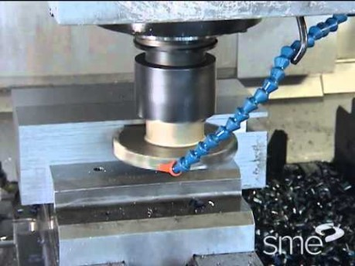
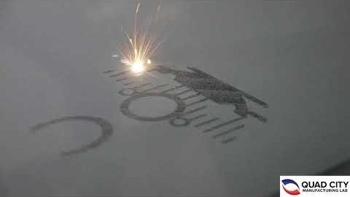
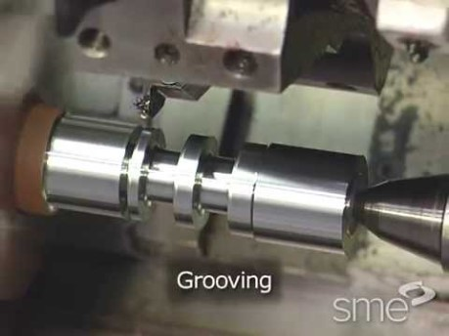
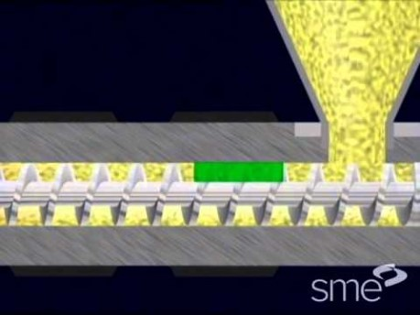
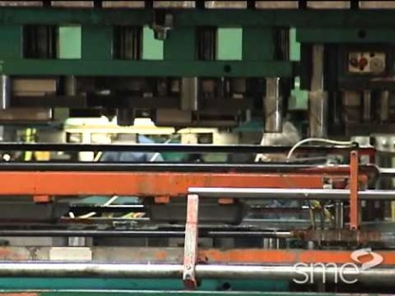
Manufacturing Processes
Milling
Additive Manufacturing
Turning
Injection Molding
Stamping
Notes:
Milling vs turning: 1. flat vs. cylindrical surface, 2. single point vs. multi-point cutter, 3. cutting speed provided by rotating cutter vs. workpiece

Slide 3
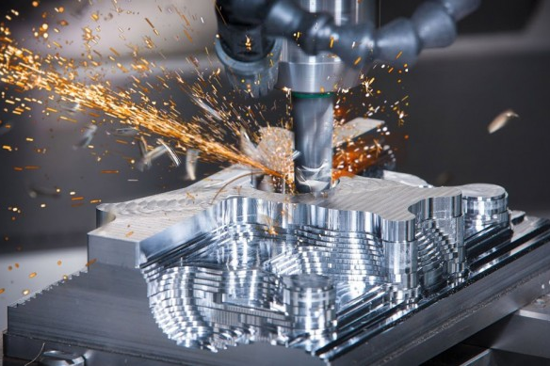
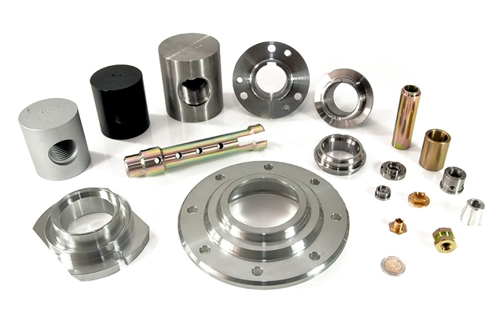
Process Monitoring
Speed
Cutting depth
Feed rate
Product Level (product quality)
Dimensional accuracy, surface roughness, residual stress
Process Level
Manufacturing efficiency (cycle time), energy efficiency, material efficiency
Machine Level
Condition (chattering), tool wear, crack, failures of mechanical parts
Notes:
Residual stress, caused by mechanical and thermal loads, as well as phase changes, leads to fatigue, component distortion and crack

Slide 4
Process Monitoring
Sensing
Product-Level Attributes
Material
Machine
Process
?
Process-Level Attributes
Control inputs
Energy
Machine-Level Attributes
Data Analytics
Notes:
Can control inputs/machine settings determine solely the attributes?
NO.
Because of process-to-process variation, environmental disturbance, variations in materials and other disturbance
The goal is to accurately estimate the attributes based on both control inputs and in-process sensing

Slide 5
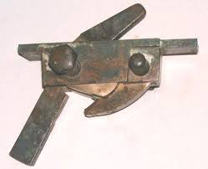
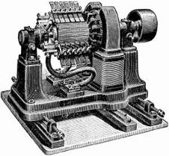
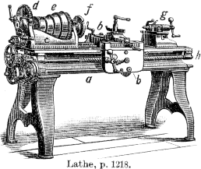
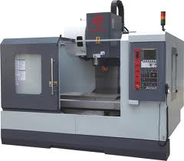
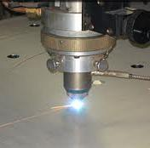
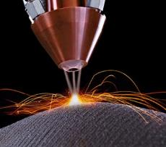
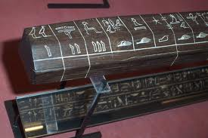

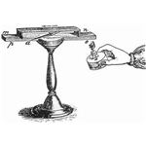
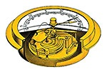
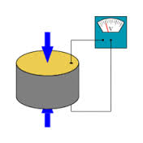
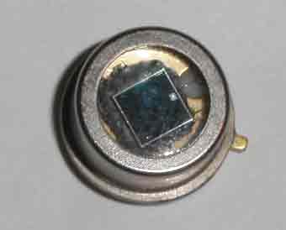
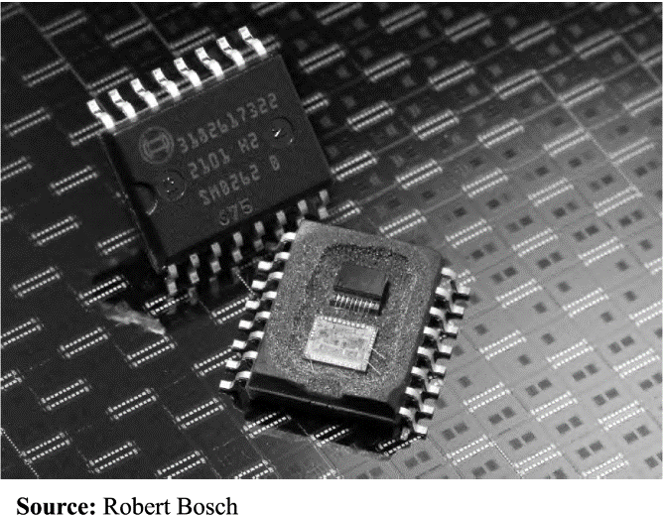
Sensing: Historical Perspective
Crossbow Trigger
Qin Dynasty
Dynamo, designed by Hippolyte Pixii
Electric ally powered, reproducibility
Programmable, multiple functions
New tooling, energy
Metal powder freeform fabrication
Laser Cutting
Ancient Manufac.
Electric Generator
Modern Lathe
CNC Machine
Additive Manufac.
230 B.C.
1830
1910
1960
1970
2010
3000 B.C.
1821
1843
1919
1950
1990
Egyptian Ruler
Seebeck & Thermocouple
Barometer
Piezo Sensor
Photodiode
MEMS Sensor
Calibration & Standard
Thermal-Electrical
Fluid-Gas Pressure
Mechanical-Electrical
Photo-Electrical
Microelectro-mechanical
Notes:
Piezoelectric Effect is the ability of certain materials to generate an electric charge in response to applied mechanical stress
Photodiodes may contain optical filters, built-in lenses, and may have large or small surface areas

Slide 6
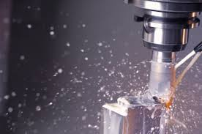
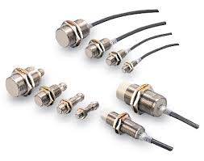
Sensing Principal: Signal Transduction Mechanisms
Acoustic Discharge Mapping
Displacement/Deformation Based Force Sensing
Residual Stress Measurement
Temperature Sensing
Physical Effects
Process Characterization
 | Mechanical | Thermal | Electrical | Magnetic | Radiant
Mechanical | Mechanical and Acoustic Effect | Friction, Cooling | Piezoelectric, Piezoresistive Effect | Magneto-mechanical | Photoelastic, Sagnac, Doppler
Thermal | Thermal Expansion, Radiometer Effect |  | Thermo-resistive/capacitive, Seebeck, Pyroelectric Effect |  | Radiant Emission, Thermo-optical Effect,
Electrical | Electromechanical, Electrokinetic Effect | Joule Heating, Peltier Effect | Charge Collectors, Langmuir Probe | Biot-Savart’s Law | Electro-optical Effect
Magnetic | Magnetomechanical Effect | Thermo-magnetic Effect | Galvanomagnetic Effect |  | Magnetooptical Effect
Radiant | Radiation Pressure | Bolometer, Thermopile | Photoelectric Effect |  | Optical Bistability, Photorefractive Effect
Chemical | Electrodeposition, Photoacoustic Effect | Calorimeter, Thermo-conductivity | Potentiometry, Gas Sensitive Field, Conductimetry, | Nuclear Magnetic Resonance | Spectroscopy, Chemiluminescence
Measurable Parameters
Electromagnetic Inference Detection
Displacement/Proximity Sensing
Notes:
The piezoresistive effect is a change In the electrical resistivity of a semiconductor or metal when mechanical strain is applied
The thermoelectric effect is the direct conversion of temperature differences to electric voltage and vice versa via a thermocouple
Pyroelectricity is a property of certain crystals which are naturally electrically polarized and as a result contain large electric fields. Pyroelectricity can be described as the ability of certain materials to generate a temporary voltage when they are heated or cooled.
A galvanomagnetic effect is described which is observed by measuring the induced voltage normal to the direction of current flow as in the Hall effect but with the magnetic field in the current-voltage plane. Can be used for electrical discharge machine monitoring (so called wire burning)
The photoelectric effect is the emission of electrons or other free carriers when light hits a material. Electrons emitted in this manner can be called photoelectrons. This phenomenon is commonly studied in electronic physics and in fields of chemistry such as quantum chemistry and electrochemistry

Slide 7
Sensing for Manufacturing
Manufacturing
Subtractive Manufact.
Net Shaping
Additive Manufacturing
−
+
Cutting
Grinding
EDM
Stamping
Rolling
Position/Dist.
Product Dimension | Dimension Material flow | Product dimension
Chatter marks Tool wear Crack generation | Flatness Strip rupture | Surface quality
Residual Stress Tool Wear | Forming depth
Surface hardness Residual stress |  | Porosity Residual stress
Vibration
Force/Pressure
Temperature

Slide 8
Tool Wear Monitoring & Prognosis

Slide 9
Tool Wear and Life Prognosis
Monitoring
Force
AE amplitude distribution within one cut
Probability
Vibration
Acoustic Emission
……
Prognosis of Wear:
Tracking and prognosis
Model physical mechanism of tool wear propagation
Predict wear propagation under given operation conditions and materials
Quantify uncertainty due to process-to-process variations and measurement error

Slide 10
Tool Wear Initiation and Propagation
Common tool wear types
Flank wear: caused by friction between tool clearance surface and workpiece
Crater wear: caused by friction between rake face and chip
Tool wear leads to poor surface finish and increase in power consumption
Rake face
Chip
Tool
Crater wear
Abrasion area
Friction
Clearance face
Work piece
Flank wear
Cutting direction
Effect of machine settings on tool wear
Increased cutting speed: increase in cutting temperature, shortened tool life
Increased feed rate & depth of cut: quadratic relationship between tool wear and feed rate
Astakhov, J. Adv. Manuf. Tech., 2007

Slide 11
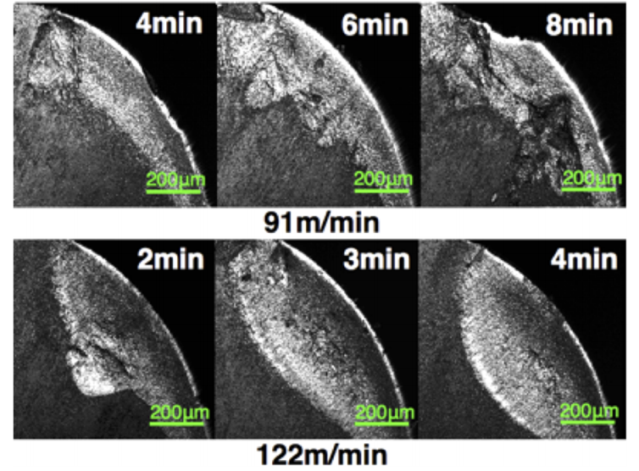
Tool Wear Propagation Modeling
Tool life model | Tool wear rate model
Taylor’s tool life equation: VL^{n}=C₁ (L: life, V: cutting speed, n,C₁=const.) | Paris law: dx/dt = CΔK^{m} (x: wear width; C, m = const.)
Taylor’s extended equation: L = C₂/(V^{p}f^{q}d^{r}) (f: feed rate, d: depth, p,q,r,C₂=const.) | Takeyama & Murata’s wear model: dx/dt = G(V,f)+Dexp(-E/RT) (E: energy, R,G,D = const.)
Hastings tool life equation TL^{n}=C₃ (T: temperature, n, C₃=const.) | Usui’s wear model dx/dt = Aσ_{n}V_{s}exp(-B/T) (σ_{n}: stress, A,B = const.)
Wear propagation model (derived from Paris law)
Relate wear to stress intensity factor
Wear width
Material-related parameters
Number of load cycles
Stress intensity factor
Stress range: constant
Schrock, Phase dependent tool wear, J. Manuf. Sci. Eng., 2014

Slide 12
Process Monitoring in Injection Molding

Slide 13
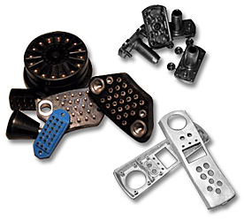
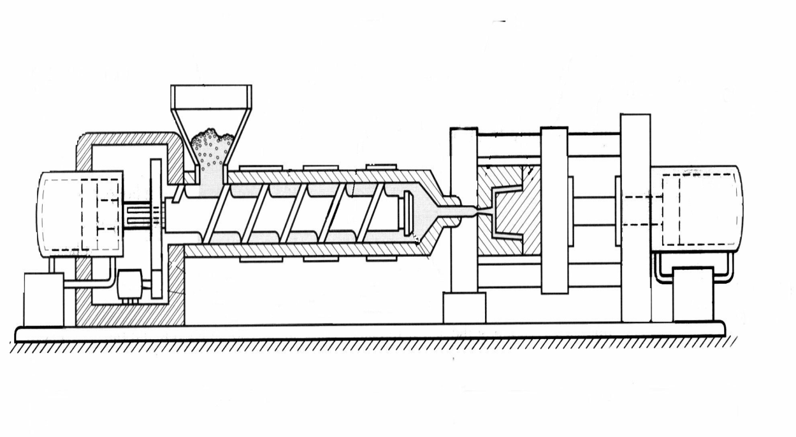
Injection Molding of Polymers
Role in manufacturing
Invented in 1872 by John Wesley Hyatt
Processing 32% of all plastics products;
Producing 10,000 – 1,000,000 parts per mold
Raw Polymer
Hopper
Screw
Clamp Drive Motor
Pressure Level: 50~100MPa
Ramping Rate:
< 100MPa/sec
Temperature：
Melt: < 400ºC
Mold: 80~200ºC
Injection Drive Motor
Hydraulic Pump
Screw Drive Motor
Barrel
Heater Bands
Nozzle
Mold
Cavity, in which parts are produced

Slide 14
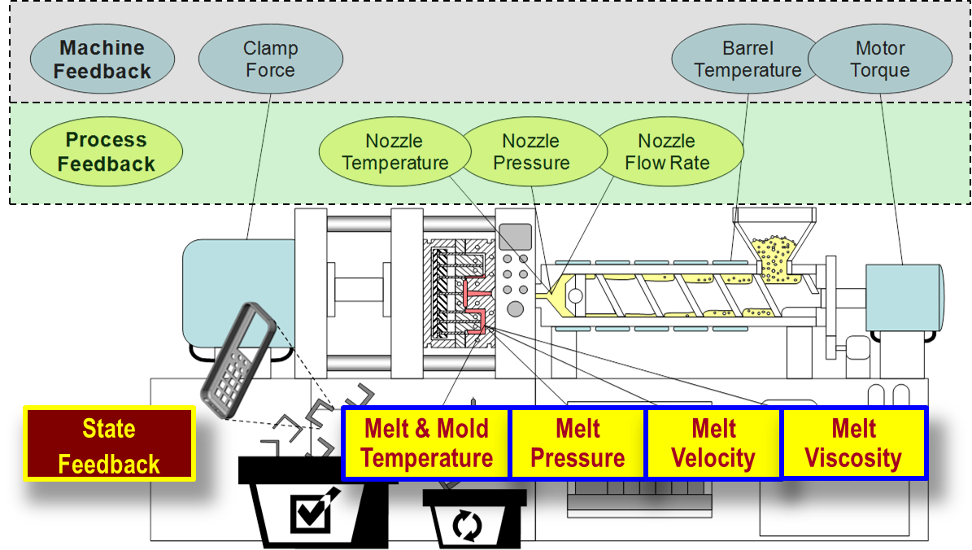
Information Feedback
Three levels of information feedback:
Machine: far away from mold cavity, only global information
Process: a level closer, but still no accurate correlation with part quality
State: directly relates part quality to melt and mold for optimal control – desired!
Need: sensor measuring multiple parameters, remote data retrieval through RF-shielded mold steel

Slide 15
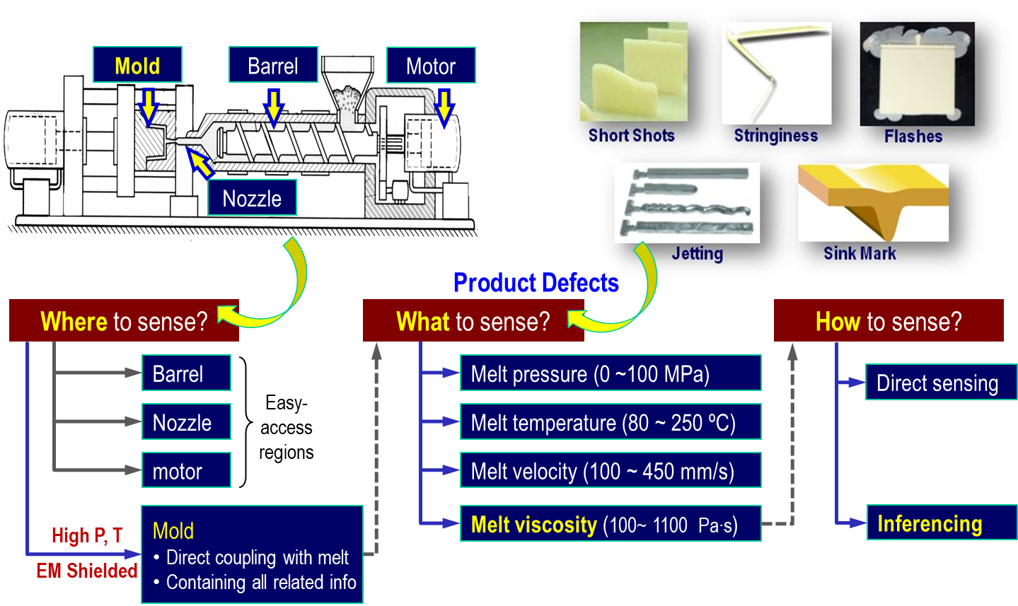
Molding Process Monitoring

Slide 16
Sensing Modality vs. Part Quality
52.5% of part quality can be explained by retrieving and analyzing information on melt pressure;
Improvement of up to 92.5% can be expected if melt temperature, velocity, and viscosity can be include in the measurement.

Slide 17
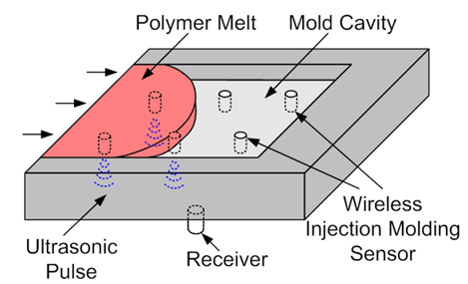
Sensing Principle
Physical Sensors
Sensing Parameters
Inferencing
Piezo-Ceramic Ring Stack
Melt pressure
Pressure Ramping Rate
Infrared Detector (thermopile)
Melt temperature
Temperature Ramping Rate
Viscosity and Velocity determined through inference from P and T measurements
Melt velocity
Melt viscosity

Slide 18
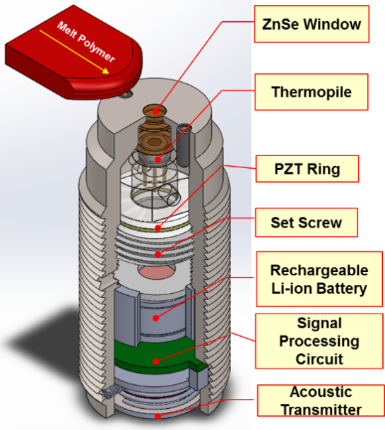
Multivariate Sensing
Multivariate Sensing (MVS)
4 parameters/sensor package
Pressure
Temperature
Velocity
Viscosity
Acoustic Wireless data transmission
Immune to electro-magnetic shielding
No through hole to be drilled on mold for remote data retrieval

Slide 19

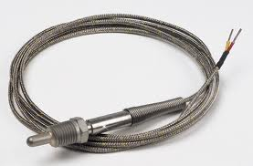

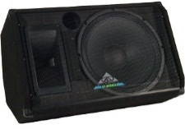
Mechanisms for Data Transmission
Data Transmission
Acoustic Transmission
Wired
Transmission
Requires drilled holes, Intrusive
Electromagnetic
Waves
Not feasible for RF-shielded media
Acoustic modulation
Wave propagation
Feature extraction
Acoustic
Waves
Non-intrusive, propagates in RF-shielded media
Wireless advantages
Improved flexibility for sensor deployment
Minimized modification on machine structure
Reduced cost on installation and maintenance

Slide 20




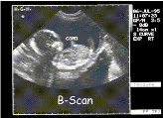
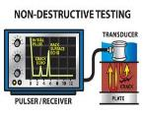
Acoustic Wave Propagation
Properties:
Longitudinal wave, particle movement direction in parallel with propagation direction
Propagate via compression and decompression of medium materials
20 Hz
20 kHz
100 kHz
2 MHz
200 MHz
Interfere with structural vibration in manufacturing machines
High attenuation,
wavelength → metal crystal dimension (mm level)
500 kHz ~ 2 MHz
Chosen for acoustic data transmission

Slide 21
Acoustic Signal Transmission
Goal: To transmit multiple parameters through metal using acoustic wave as info carrier
Challenges
Determine carrier frequencies for modulation.
Design transmitter to convert modulated signal into acoustic wave.
Data (Decimal)
Digits (Binary)
{81, 82, 83, 85, 90…}
Unit: [ ºC ]
{01010001 (81)….}
{24, 33, 45, 59, 61…}
Unit: [ MPa ]
{00011000 (24)….}
{200, 211, 232, 217…}
Unit: [ mm/s ]
{11001000 (200)….}

Slide 22
Process Monitoring in Stamping

Slide 23

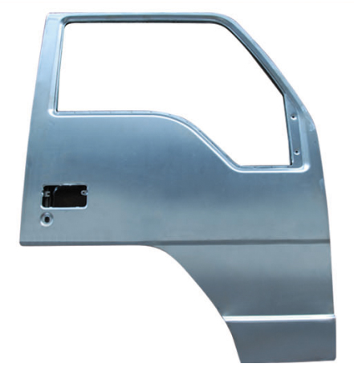
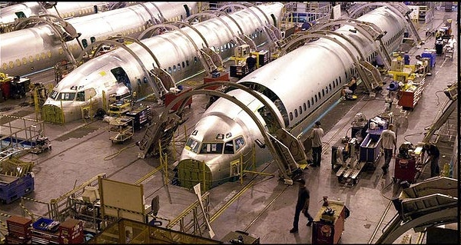
Stamping
Salient Features
Fast operation
Cold working improves stiffness
Widely Used
Cans (230x109 cans/year)
Automobiles (300+ parts/car)
Aviation, naval, etc.
$20.6 B revenue in 2008 for automobile industry
Motor Vehicle Metal Stamping Industry in the U.S. and its Foreign Trade
Study Report, Supplier Relations, March 2009

Slide 24
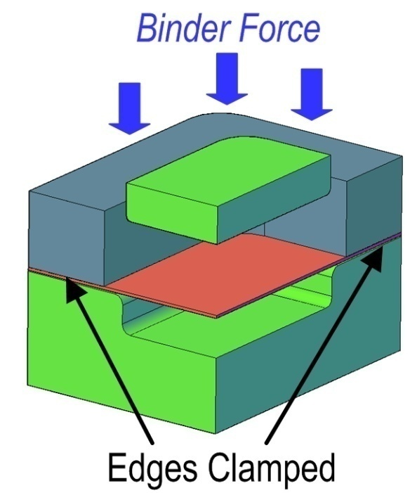
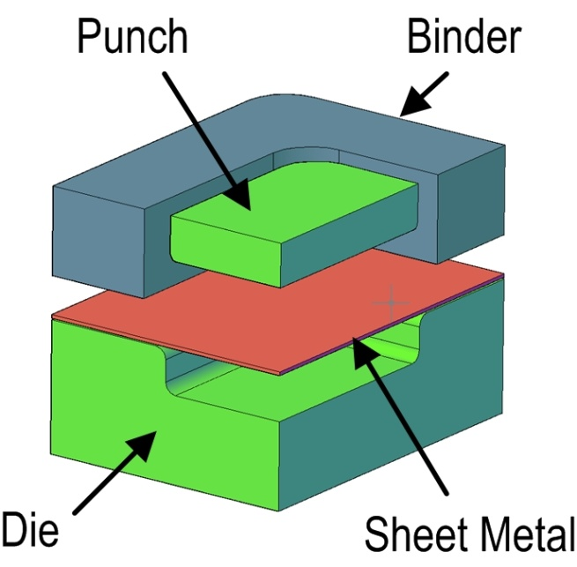
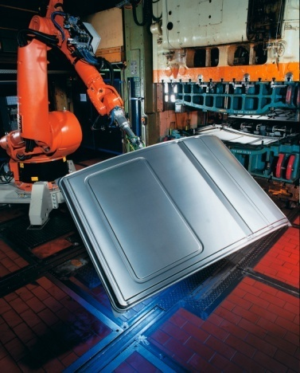
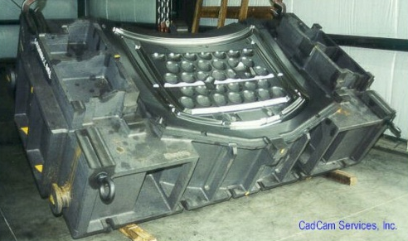
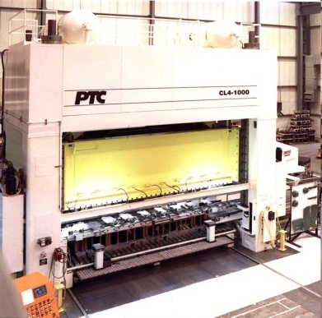
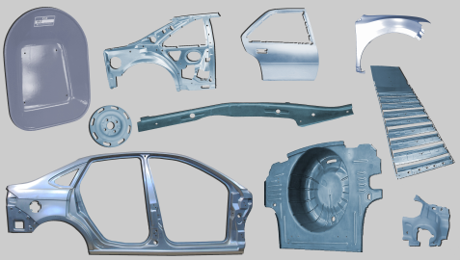
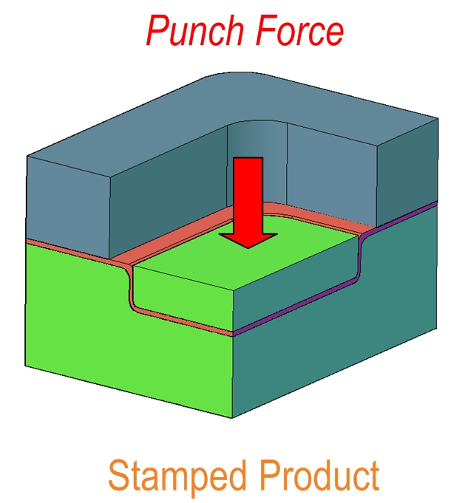
Stamping Process
Mechanism
Stamping of sheet metal
Tools: binder, punch, and die
Steps
Edges of sheet clamped by binder
Sheet formed into die cavity by punch

Slide 25
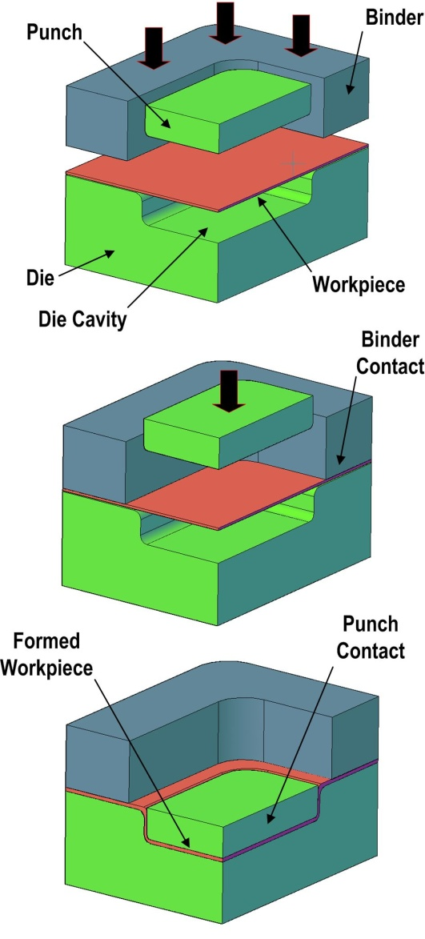
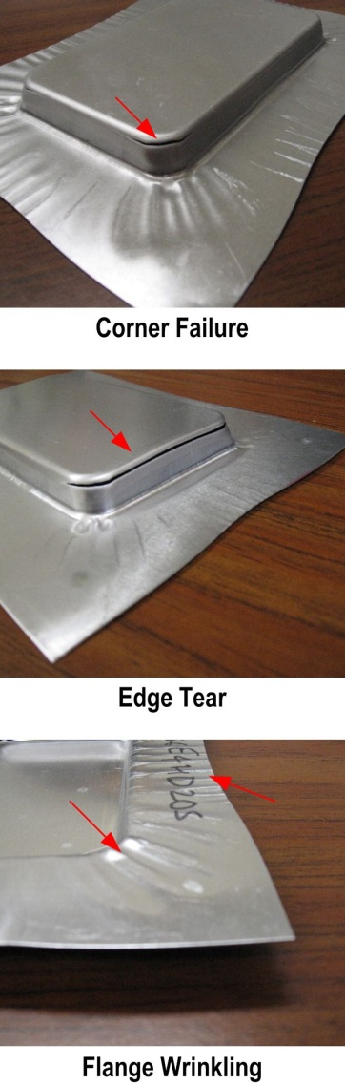
Workpiece-Tool Interaction
Variations in the tool-workpiece interaction lead to defective parts
Causes:
Die misalignment
Uneven binder pressure
Slide non-parallelism
Shut height variation
Die flexing
Lubricant distribution
Spring back
Spatio-temporal Contact Pressure Distribution aids in defect detection
Other benefits
Understanding process mechanism
Tool wear monitoring
Better tool designs
Some Common Defects
Section of
Stamping Setup

Slide 26
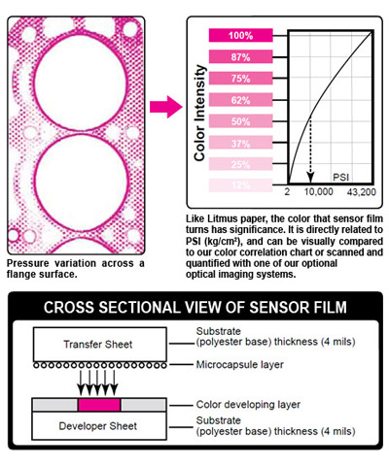
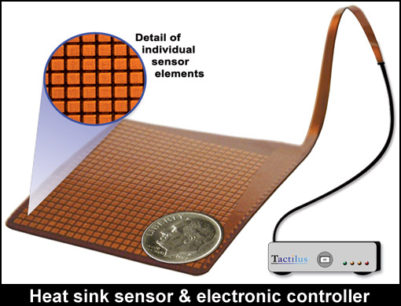
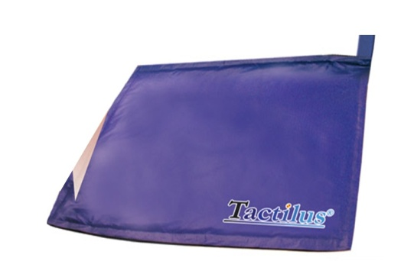
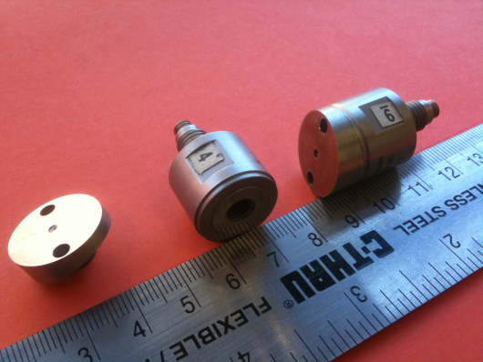
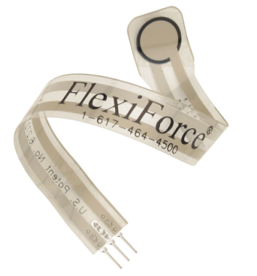
In-Die Pressure Sensing
Ink based systems
Plastic films with ink microcapsules
Pressure burst capsules, color intensity indicates pressure
Static measurement – single use
May wrinkle or tear on 3D shapes
Matrix systems
Matrix of small piezo-resistive or piezo-electric elements
Dynamic measurement
Can not be used on 3D shapes
Limited range (e.g. 863 kPa)
25 x 25 array
32 x 32 array
2 mm x 2 mm
50 mm
30 cm
Discrete sensors
Thin film button cells
Quartz dynamic force sensors
Divide force by sensing area
TF Sensor
Dynamic Force Sensors

Slide 27
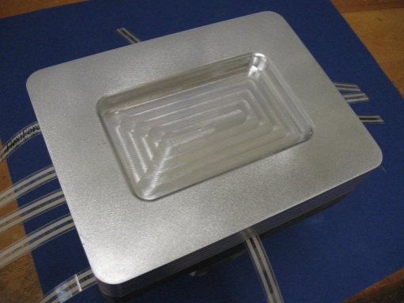
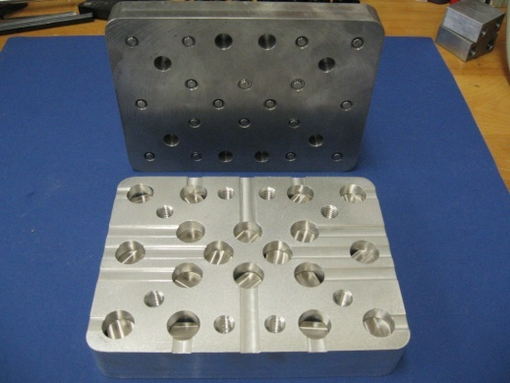



Sensor Integration Techniques
Two methods investigated
Bottom mount: Sensor installed in a blind hole drilled from the back of die. Die working surface not altered in any manner. Sensor behavior is controlled by the embedding depth
Top mount: Sensor installed in a hole drilled in the working surface of the die. Sensor behavior controlled by the clearance
Bottom Mount
Top Mount

Slide 28












Pressure Sensing
Top mount: local pressure distribution studied by matrix sensor with 625 elements
High clearances (~0.001” or 25.4 μm) disturb original pressure distribution
Assembly Process
Piezo Quartz Sensor
R = 10 mm
Range: 10 KPSI/ 70 MPa
0.001” or 25.4 μm
0.002” or 50.8 μm
Ground Finish
0.0005” or 12.7 μm
Distortion of original pressure distributions
Flat Surface
Cylindrical
Contact Surface
Flat
Contact Surface
50 mm
Cylindrical Surface
Matrix Sensor
25 x 25
Minimum Disturbance
Sampling: 100Hz
Range: 125 PSI/ 863 KPa
50 mm
Sensing Element
2 mm x 2 mm
KPa
Net Testing Force : 200 N (Limited by matrix sensor range)

Slide 29



Pressure Reconstruction
Tool-workpiece interaction governed by contact pressure
Pressure sampled by sensors at discrete locations
Seek mathematical techniques for pressure reconstruction
. . . . . . . . . .
Estimated
Pressure

Slide 30
Process Monitoring in Chemical Mechanical Polishing Process

Slide 31



CMP
A process of planarizing wafer surfaces by using a combination of chemical reactions and mechanical forces
The global CMP market: $3.32 Billion in 2014, and is estimated to reach $ 4.94 Billion by 2020 (with rate of 6.83%)
RMS of surface protrusions
63.1 nm
10.7 nm
5.8 nm
Before CMP
After 1st CMP
After 2nd CMP
(Borst et al., Thin Solid Films, 2001)
(Sung et al., Ultra-smooth BaTiO₃ surface morphology, Materials Science in Semiconductor Processing, 2015)
Notes:
Copper Electrochemical Deposition (ECD): a process used for plating copper electrical conductor on printed circuit boards
TaN: the abbreviation for Tantalum, a chemical element. TaN barrier is to prevent copper (Cu) diffusion into the silicon

Slide 32


CMP Mechanism
Dow Electronic Materials, Fine-tuning CMP Slurries for 3D TSV Processes, 2017
Chemical reaction
Hydroxyl ions attack SiO₂ in oxide CMP, causing surface softening and chemical dissolution
Oxidants enhance metal dissolution and control passivation in metal CMP
Mechanical abrasion
Soften surface removed by abrasives suspended in the slurry and the friction between the pad and the wafer
Material Removal Rate (MRR): Critical indicator for CMP monitoring

Slide 33


Parameters Affecting MRR
Slurry
Type
Abrasive size
pH Value
Abrasive hardness
Concentration
Flow rate
Additive
Zeta potential
Others
Temperature
Polishing time
Dresser
Conditioning motion
Abrasive type
Abrasive density
Abrasive configuration
MRR [nm/min]
Wafer
Pressure
Pattern hardness
Film type
Wafer size
Pad
Hardness
Compressibility
Relative speed
Worn degree

Slide 34



MRR Modeling
Model 1: Pressure and relative rotational speed
Model 2: Abrasive number, geometry, pad hardness and deformation
Constant
Pressure
Relative speed
Wafer density
Abrasive number
Removal by single abrasive
Preston Equation ^{[1]}
Exponential coefficients, α and β, vary with wafer materials, within [0, 1] ^{[2]}
SSiC: sintered silicon carbide
HIPSN: hot-isostatically pressed silicon nitride
b: ratio of the real contact area between abrasives and wafer over apparent area, determined by applied pressure on wafer and wafer’s Young’s modulus
Ceria: ceria oxide
Zirconia: Zirconium oxide
(Luo and Dornfeld, IEEE Semiconductor Manufacturing, 2001)
[1] Preston, J. Society of Glass Technology, 1927
[2] Tseng and Wang, J. Electrochemcial Society, 1999
[3] Figure from Klocke and Zunke, CIRP Annals, 2009
Abrasive size

Slide 35




MRR Modeling
MRR vs. Wafer Hardness
(Dambon and Demmer, CRIP Annals, 2006)
MRR vs. Polishing Agent
(Takaya et al, CRIP Annals, 2011)
MRR vs. Pad Condition
(Byrne et al, CRIP Annals, 1999)
MRR nm/min
MRR vs. Chemical Effect
(Lee and Jeong, CRIP Annals, 2009)
Challenges in modeling MRR:
Difficult to include all process parameters considered in one model
Hard to quantitative effect of chemical reaction

Slide 36
Process Monitoring in Additive Manufacturing

Slide 37








AM: Milestones
Representative AM Technologies
Stereolithography Apparatus
(1987)
Fused Deposition Modeling
(1991)
Selective Laser Sintering
(1991)
Polyjet
(2005)
1990
2000
2010
2020
First 3D printed organ
(synthetic scaffold)
(1999)
First usable 3D printed prosthetic Leg
(2008)
FAA approved 3D printed part for Boeing 787
(2017)
3D printed blades for GE aircraft engine
(2018)
Representative Applications
Stratasys; GE; Boeing

Slide 38




Major AM Technologies
AM technologies: market share
Others
Fused Deposition Modeling (FDM)
Stereolithography Apparatus (SLA)
Selective Laser
Sintering (SLS)
Filament
Powder feeder
Elevator
Laser system
Extruder
Part
Part
Recoater
Sweeper
Support
Powder bed
Resin
Part
Mirror
Platform
Overflow bin
Laser system
Plastic filament melt & deposition
Solid powder fusion by laser
Liquid resin hardened by UV light
 | Cost | Material | Surface | Strength
FDM | Low | Wide | Rough | Low
SLS | High | Limited | Rough | High
SLA | High | Limited | Smooth | Low

Slide 39

Fused Deposition Modeling
Acrylonitrile Butadiene Styrene (ABS) or
Polylactic Acid (PLA)
Filament heated over transition temperature before deposition
Nozzle moves in x and y directions, allowing different printing paths
y
x
Platform moves in z direction, allowing part built layer by layer
z

Slide 40

FDM Process
Stratasys Direct Manufacturing, 2017

Slide 41



FDM Process: Overview
Strengths
High cost-effectiveness
Wide options of materials
Rapid prototyping
Machine cost ($)
FDM | ~2k
SLS | ~150k
SLA | ~80k
Printing speed (mm/h)
FDM | 50~150
SLS | Up to 48
SLA | Up to 14
Sculpteo, 2017
Limitations
Relatively low precision, surface smoothness, tensile strength (due to low bonding force between layers)
Influenced by multiple process factors, difficult to control the part quality, due to insufficient understanding of process-property relationships
vs.
15 layers
Printed by FDM
Printed by SLS
Wu et al., Influence of layer thickness, Materials, 2015

Slide 42


FDM Qualitative Modeling
FDM process traditionally analyzed qualitatively
Experimentally obtained part property variation curve through adjusting process parameters
Surface roughness vs.
printing speed/feed rate
Surface roughness vs.
extruder temperature
Substantial understanding and modeling of FDM process
Requires quantitative modeling of process parameters/variables - part property relationship
Provides technology basis for address the part property inconsistency through process parameter optimization
[1] P Rao et al., Quality monitoring in additive manufacturing, J Manuf Sci Eng, 2015
[2] V Kovan et al., Printing parameters effect, J Mech Sci Technol, 2018

Slide 43



FDM Quantitative Modeling
Process Parameter
Thermal Behavior
Extruder temp.
Layer #1
Layer #2
Layer #3
Printing speed
Microstructure
Layer height
Temperature (℃)
Property
Material
Time (s)
Performance
Stress (MPa)
Tensile strength
Thermal behavior affected by process parameters
Strain (%)
Layers’ interactions affect their microstructure
Surface roughness
Joint effect of process parameters and layers’ interactions on property
Requirements for quantitative modeling of process-property relationship in FDM
Characterize thermal interactions among layers;
Describe effects of process parameters and layers’ interactions simultaneously;
Relate to final part property.

